Slide 1
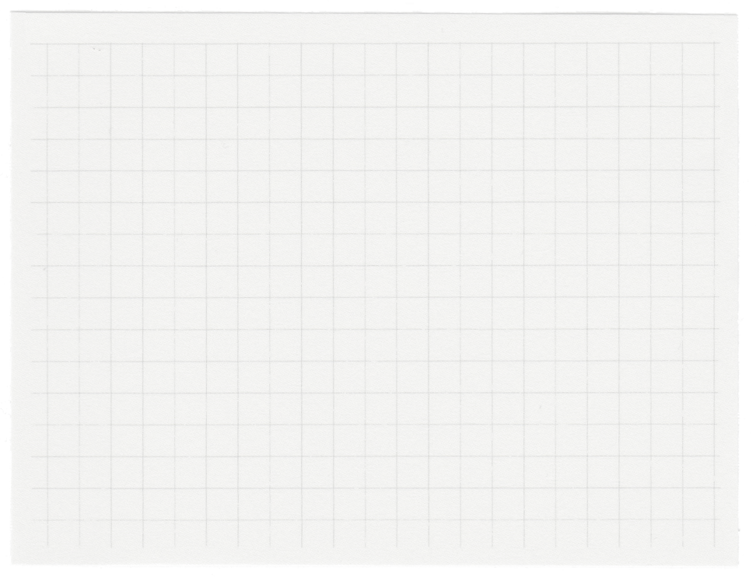













Project presentation
GROUP -G14

Slide 2
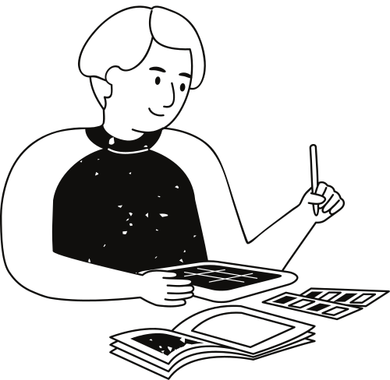
PROBLEM STATEMENT
INCLUSIVE LEARNING TOOLS:
DEVELOP SOLUTIONS TO ASSIST STUDENTS WITH DISABILITIES,SUCH AS SPEECH-TO-TEXT TOOL OR AR FOR VISUALLY IMPAIRED LEARNERS

Slide 3
Purpose of Choosing the Problem Statement
We chose this problem statement to bridge the accessibility gap for visually and speech-impaired individuals, empowering them through innovative technologies like text-to-speech and gesture recognition. Our goal was to enhance learning, communication, and independence while raising awareness about the importance of inclusive design. By leveraging technology for social good, we aimed to break barriers, foster empathy, and inspire a future where accessibility and equality are fundamental to innovation.

Slide 4
Develop user-friendly tools like speech-to-text solutions and AR-based applications for enhanced accessibility.
01.
Project vision and mission
Integratecutting-edge technology to address specific needs of disabled learners.
02.
Empower students with disabilities through innovative and inclusive learning tools, enabling equal access to education and fostering opportunities for personal and academic growth.
Promote inclusive education by bridging the accessibility gap through impactful solutions.
03.

Slide 5
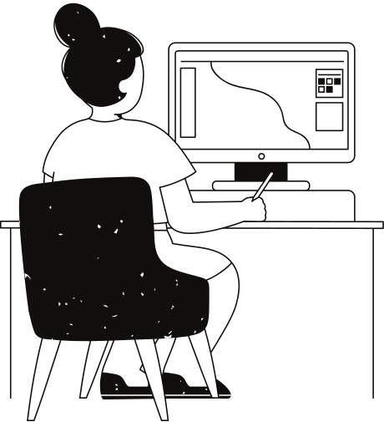
ABSTRACT
Our Inclusive Learning Tool is a groundbreaking solution designed to empower students with disabilities. The core feature of this tool is an API for Sign Language to Text conversion, enabling individuals who communicate through sign language to have their gestures seamlessly translated into written text in real-time.
This innovation fosters effective communication and ensures inclusivity in educational environments. Designed with accessibility in mind, the tool also incorporates high-contrast themes, large fonts, and keyboard navigation, providing a user-friendly interface for all.
By focusing on inclusivity and removing communication barriers, this tool creates equal learning opportunities for students with disabilities and bridges the gap in accessible education.

Slide 6
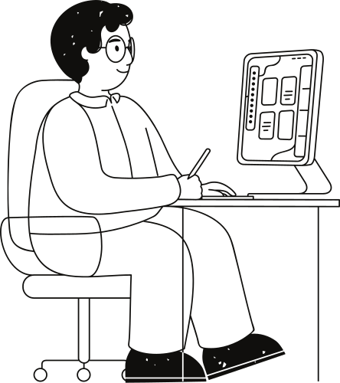
Creation process
The creation process starts with conceptualization, where we define the features and functionalities needed to tackle accessibility challenges, focusing on translating sign language into text through a dedicated API. During the design and planning phase, we create detailed workflows and develop an intuitive interface to ensure seamless interaction for users with disabilities.
In the development stage, the core API for recognizing and interpreting hand gestures is implemented using advanced programming frameworks, with a focus on accuracy and efficiency. This is followed by rigorous testing and refinement, where prototypes are iteratively improved based on feedback from users and accessibility experts.
Finally, the solution is deployed on compatible platforms, with ongoing monitoring and updates to ensure optimal performance, usability, and inclusivity for all users. This process ensures a robust and impactful tool that bridges communication gaps effectively.

Slide 7
METHODOLOGY
01
02
03
04
Problem analysis:
Study existing tools and challenges faced by students with disabilities to identify gaps in accessibility.
Solution Development
Design and prototype image -to-speech and AR tools tailored for effective learning experiences.
Testing and Optimization
Simulate usage scenarios to test functionality and make improvements for better performance.
Implementation and Assessment
Deploy the tools and evaluate their effectiveness in addressing accessibility challenges.

Slide 8

HARDWARE
SOFTWARE
Input Devices:
Microphones for speech-to-text functionality.
Cameras for AR features like object recognition.
Sign Language to Text Integration: APIs designed to recognize and translate hand gestures into written text, enabling seamless communication for non-verbal users.
Processing Units:
Computers or servers with high processing power for AI and AR computations.
AR Development Tools:
Platforms like ARKit (iOS) or ARCore (Android).
REQUIREMENTS
HARDWARE AND SOFTWARE
Display Devices:
Monitors, projectors, or tablets for visual output.
Programming Frameworks:
Python, JavaScript, or Unity for application development.

Slide 9
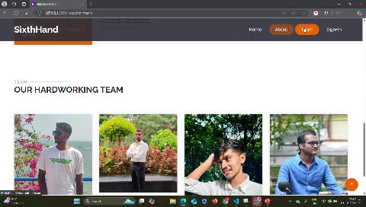
PROJECT IMPLEMENTATION

Slide 10
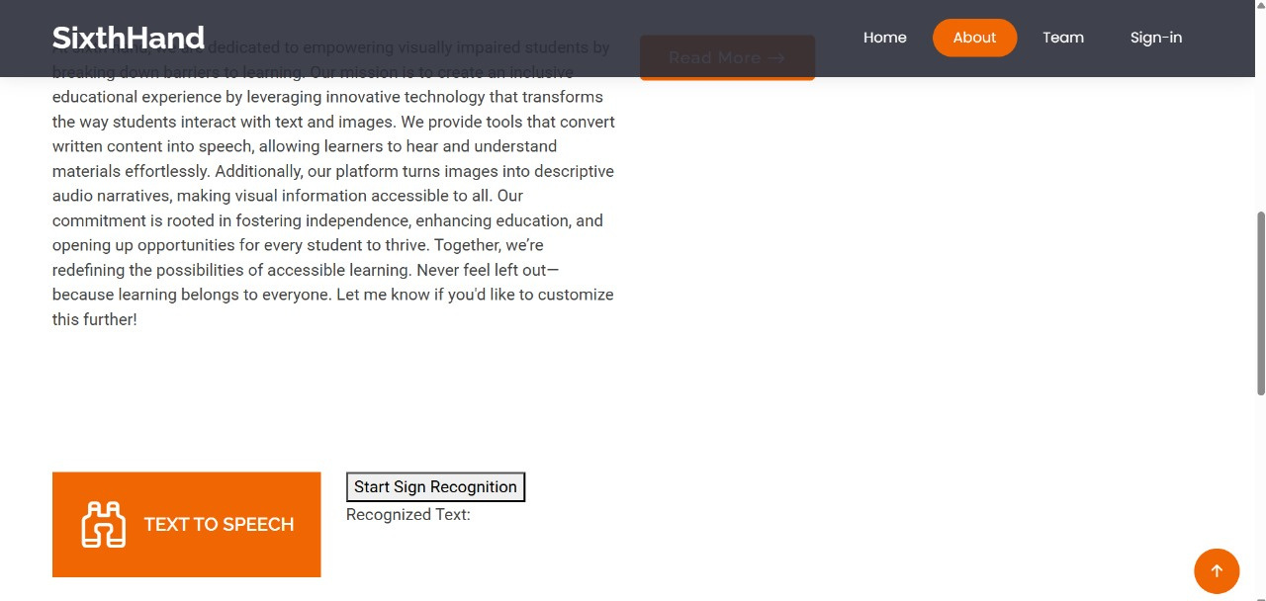

Slide 11
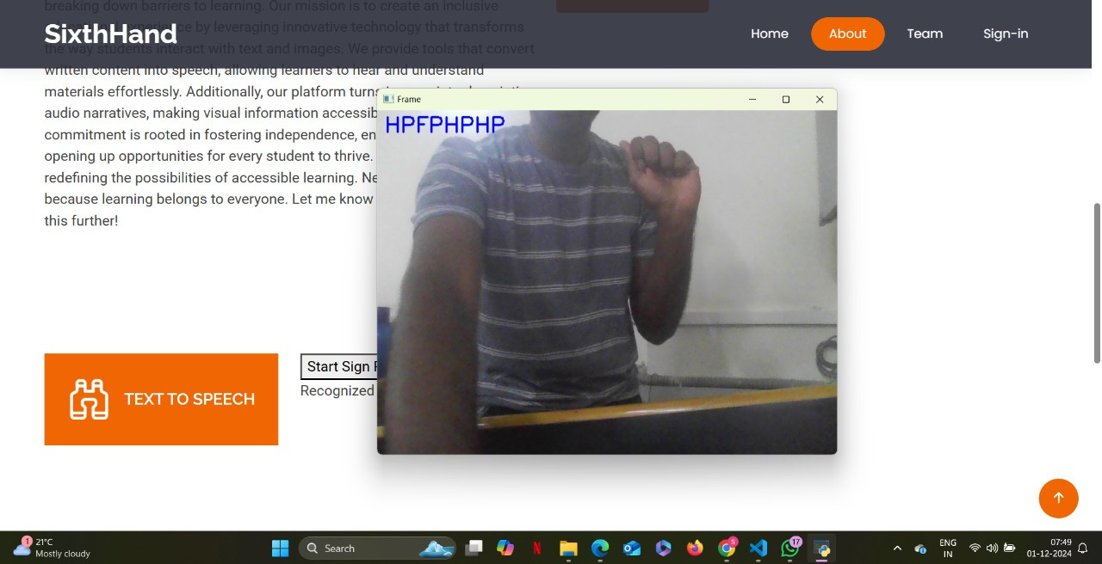

Slide 12
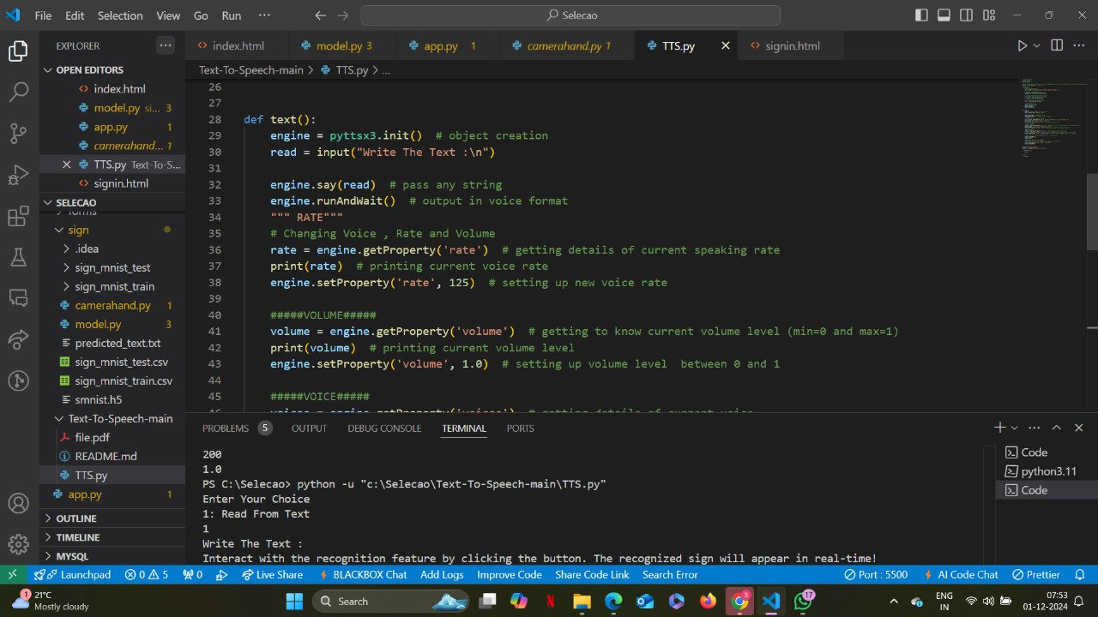

Slide 13
PROJECT DESCRIPTION
SixthHand: Empowering Learning Through Accessibility
SixthHand is an innovative platform designed to break barriers and promote inclusivity for individuals with disabilities. This user-friendly application combines advanced technology with a compassionate approach to cater to the needs of visually and speech-impaired individuals.
Key Features:
Text-to-Speech for the Visually Impaired: Converts written content into audible speech, enabling users to access and understand materials effortlessly.
Gesture-to-Text for Muted Individuals: Transforms sign language or hand gestures into text, fostering seamless communication and learning opportunities

Slide 14
OUR TAKEAWAYS
Takeaways from the Project:
The Importance of Accessibility: We realized how essential it is to build tools that cater to the specific needs of differently-abled individuals, fostering inclusivity in education and communication.
Technical Challenges and Learning: Developing this platform required integrating technologies like gesture recognition and speech synthesis, which enhanced our understanding of computer vision, machine learning, and natural language processing.
Empathy in Design: Creating user-centered solutions reinforced the importance of empathy in technology development, emphasizing usability and real-world impact.
Teamwork and Problem-Solving: This project highlighted the value of collaboration, as solving complex challenges required pooling diverse ideas and skills.
Scalability and Future Impact: We learned the significance of designing solutions that not only solve immediate problems but are also scalable and adaptable to future needs.

Slide 15
Thank you very much!

